Slide 1
MacArtney Winch for Eurofleets

Slide 2
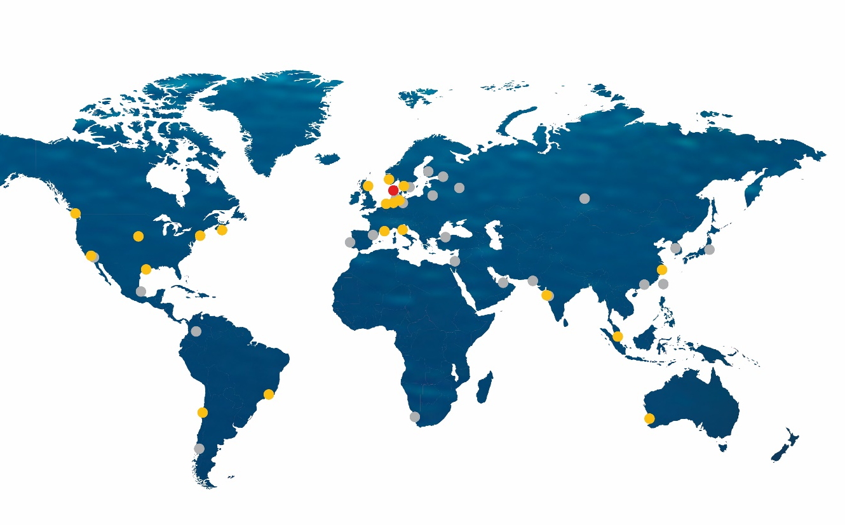
World-wide sales and service support
Group headquarters
Esbjerg, Denmark
Operations and sales offices
21 locations in Europe, North America,
Asia and Oceania
Distribution network
24 locations around the world
Founded in 1978 by Martin and Winnie MacArtney ~ 450 employees in group companies
Notes:
MacArtney A/S was founded in Esbjerg in 1978 and is the Group headquarters. In the early days, the main activity of MacArtney was that of a sales representative, selling and distributing underwater technology products in Europe. Later on a cable moulding and repair workshop was added, enabling MacArtney to provide service and small scale production to the portfolio. From this, the company has evolved step by step to be where we are today with vast engineering competences allowing us to offer complete turn-key system solutions to our customers and a network of subsidiaries and local distributiors across the globe.

Slide 3
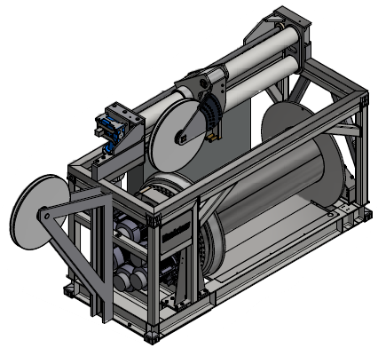
JRA 3.2.2 Winch
T3.2.2 Multipurpose winch
The winch is based on MacArtney’s more than 30 years of experience with whinches and handling equipment
February 25th 2021 Eurofleet+ General Assembly

Slide 4
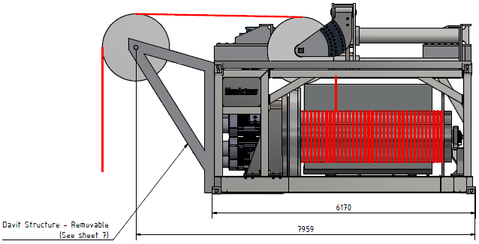
JRA 3.2.2 Winch
T3.2.2 Multipurpose winch
20’ container footprint
Welded steel structure -
Right angle level wind for optimized deck space
Optional davit, for stand alone applications
Modular build
Swappable drum
Optional Active Heave Compensation
Optional Constant Tension functions
February 25th 2021 Eurofleet+ General Assembly

Slide 5
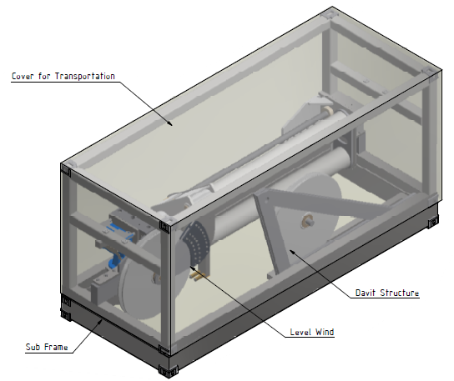
JRA 3.2.2 Winch
T3.2.2 Multipurpose winch
Modular build
Allowing for shipping in parts (lower weight)
Shipping frame for :
Level wind
Optional davit
February 25th 2021 Eurofleet+ General Assembly

Slide 6
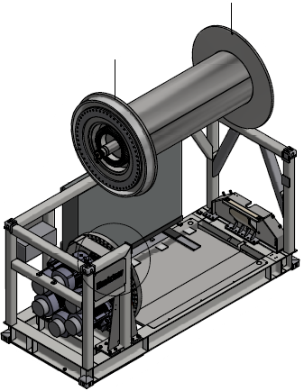
JRA 3.2.2 Winch
T3.2.2 Multipurpose winch
Swappable drum
Allowing for shipping in parts (lower weight)
Allowing for more than one preconfigured drum, with rope or umbilical.
The drum is prepared for electrical/optical slipring
February 25th 2021 Eurofleet+ General Assembly

Slide 7
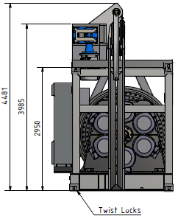
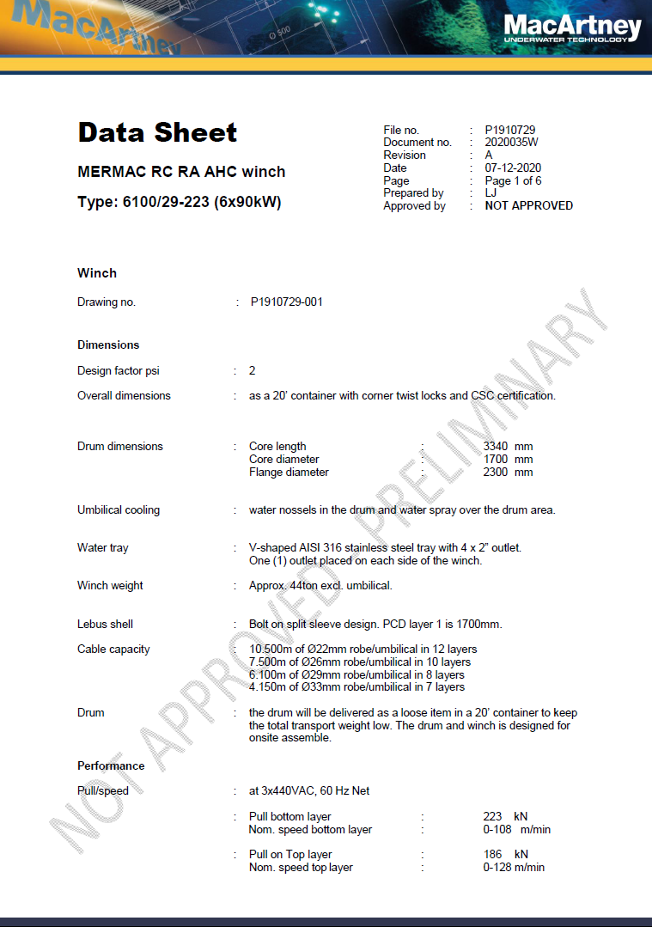
JRA 3.2.2 Winch
T3.2.2 Multipurpose winch
Preliminary specifications:
Drum size:
Core length: 3340mm
Core diameter: 1700mm
Flange diameter: 2300mm
Rope/cable capacity:
10.500m of Ø22mm in 12 layers
7.500m of Ø26mm in 10 layers
6.100m of Ø29mm in 8 layers
4.150m of Ø33mm in 7 layers
February 25th 2021 Eurofleet+ General Assembly

Slide 8
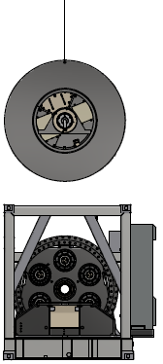
JRA 3.2.2 Winch
T3.2.2 Multipurpose winch
Preliminary specifications:
Pull force:
Pull at bottom (1st) Layer: 223kN
Pull at top layer: 186kN
Speed:
Speed at bottom (1st) Layer: 0-108m/min
Speed at top layer: 0-126m/min
(top layer data is depending on rope/cable configuration)
Temperature range:
Operations: -2º to +30ºC
Storage: -20º to +50ºC
February 25th 2021 Eurofleet+ General Assembly

Slide 9
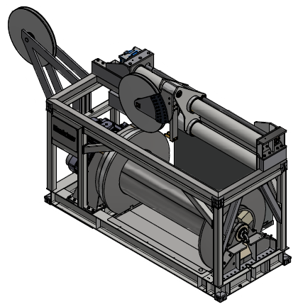
JRA 3.2.2 Winch
T3.2.2 Multipurpose winch
Preliminary specifications:
Certifications – all optional:
System certification: DNVGL-0378 (lifting appliance)
Lifting certification: ILO1.5.2
Container certification: CSC
Standards:
Electrical standard: DNV-OS-D201
Ingress protection: No less than IP56
Electrical standard: DNV-OS-D201
Paint: C5M ISO 12944
February 25th 2021 Eurofleet+ General Assembly

Slide 10
World-wide sales and service support
Group headquarters
Esbjerg, Denmark
Operations and sales offices
20 locations in Europe, North America,
Asia and Oceania
Distribution network
24 locations around the world
Founded in 1978 by Martin and Winnie MacArtney ~ 450 employees in group companies
Notes:
From the start in the bedroom of Mac and Winnie’s private home, MacArtney is now housed in a modern, purpose-built facility in Hjerting, 10 km north of Esbjerg. The office has, like the company itself, undergone an immense evolution, where the office and workshop space has been extended almost every 2nd to 3rd year. Lastly – in 2016, MacArtney purchased the neighbouring compound, whereby the total office and workshop space has been doubled to approx. 7,000 m2 and 20,000 m2 of land. The recent addition will be rebuilt into workshop and production space, stores, shipping and receipt area and a new canteen.

Slide 11
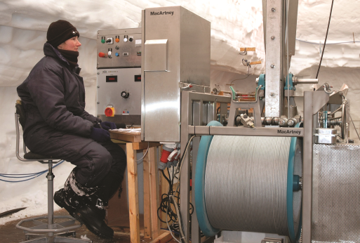
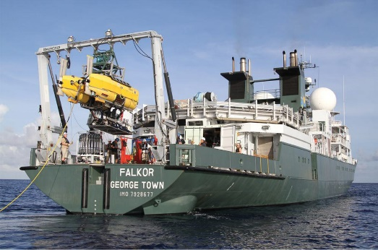
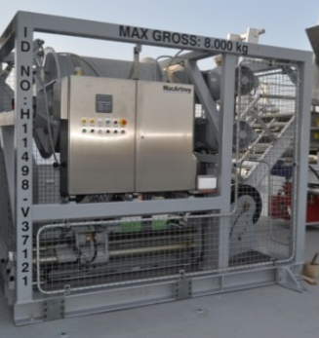
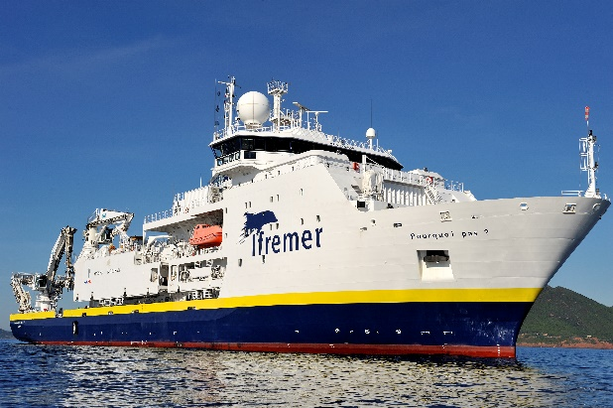
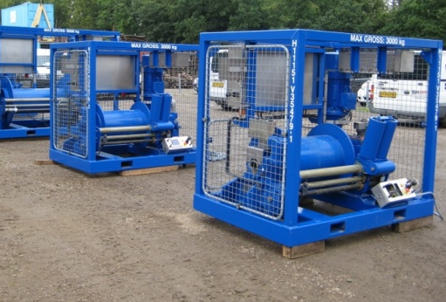
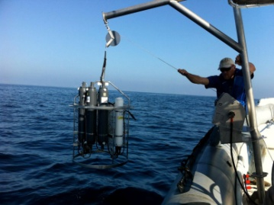
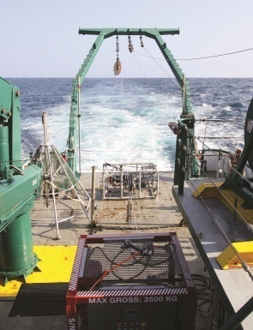
MacArtney supplies the ocean science market – winch and handling systems
Ice core drilling winches
Articulating A-frames
100 -10,000 m CTD
winches
Complete Research Vessel solutions
Multi purpose winches
Micro winches
ROV winches
Notes:
This slide shows examples of recent deliveries of winch and handling systems to the Ocean Science market.
The Ocean Science market is in many ways helping us to develop new products, as this market segment often are requiring new ”tools”. When addressing this market segment, we should know that our complete port folio within winch and L&R system be relevant. As it can be seen on the slides, then everything from the smallest Cormac M to big AHC winch systems has been sold into this market.
Specific attention should be directed to complete ”over the side handling” system for research vessels. We have a good track record within these types of customers. Recent deliveries of complete winch packages include 2 Research vessels to JAMSTEC in Japan, to the ”RV Pourqoi Pas” belonging to Ifremer in France and to the ”RV Falkor”, Smith Ocean Institute in the US.
Our Cormac Q & M series are execellent multipurpose winches for coastal research and environmental monitoring vessels and even for small launches and ribs.
Each of the pictures represent a case:
Upper left:
Ice core drilling winches have been delivered til British Antarctic Survey (BAS) historically and again recently for ice core drilling in the Antarctic. BAS has been using our winches since the early 90’ies and they keep coming back because they have a good track record with the MacArtney winches, which in essence are customised versions of our Cormac series.
Upper mid and right:
The picture shows the RV Falkor belonging to SOI. Internally we talk about this as the ”Google” ship. Smith Ocean Institute is a new Ocean Science institution founded by Eric B. Smith, the former CEO of Google and his wife. The Falkor is probably the best equipped Research vessel of this time. SOI is constantly requiring the latest and greastest technology to support the science missions and MacArtney was preferred over other suppliers of L&R and winches due to our technical capabilities and willingness to design and deliver a customised solution for the RV Falkor. The picture shows our very first delivery of our articulating A-Frame. SOI is very proud of this A-Frame and the exposure we have received has originated many new inquiries and also other orders for articulating A-frames.
The A-Frame can articulate approx. 160°, so that it folds all the way back
Right next to the Falkor image, a CTD winch is shown. This winch (MERMAC s40) was also delivered to the RV Falkor and hold up to 10.000m 8,2mm CTD cable. The winch has a removable drum (that i why the drum is mounted in the top of the winch.
Below left:
This picture shows 3 of a series of 4 Multipurpose winches (MERMAC S20 size) delivered to WHOI – Woods Hole Oceanographic Institution, in the US. WHOI is probably the worlds most renown Oceanographic Research Institute. The contract for these winches was secured in competition with a number US based winch manufactureres, because MacArtney was the only supplier that was able to comply to the requirements from WHOI. The winches are now part of the so-called ”East Coast Winch Pool”, where researchers from all over the US can ”rent” the winches for their research programmes. Other customers for MMERMAC S series of winches include: Fisheries High School, Norway - Indonesian Fisheries Research Institute (via EMS, Spain)
Ifremer, Brest, France – Institute of Baltic Sea Research (IOW), Germany, Jamstec, Japan and many more
Below mid:
This picture shows a Cormac M winch and J-frame delivered to UCLA in the US. The system is portable, but here installed on a rib. The is mounted on a J-frame. The system is designed to carry a small watersampler carousel with up to 6 pcs. 5 ltr. Bottles and a CTD with a total weight of up to 120kg. The winch holds upto 650m of Ø=3,2mm conducting cable. The Cormac M series comprises 5 models.
Below right:
This picture shows a MERMAC S20 Winch (just the top of it) sold to the RV Pelican, Florida together with a customised NEXUS Multiplexer.

Slide 12
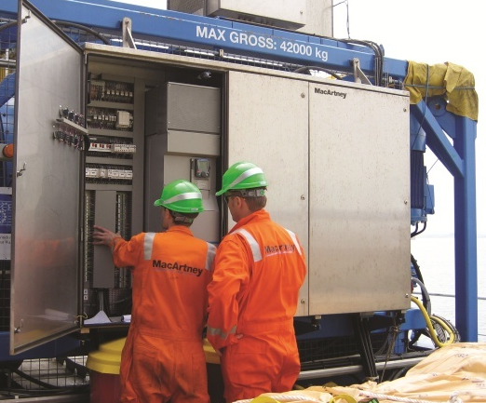
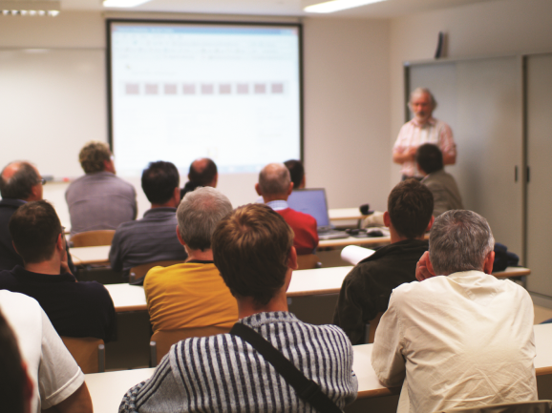
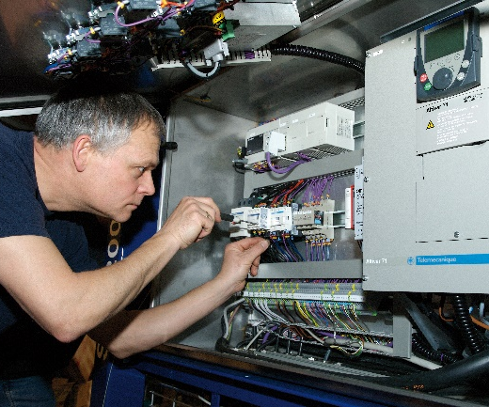
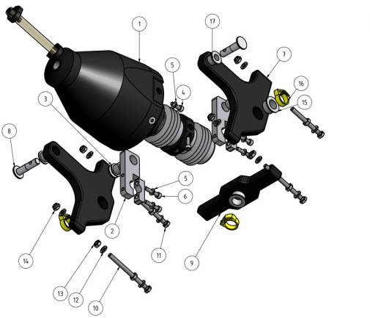
MacArtney service programme
Comprehensive service and maintenance programme for all MacArtney systems
Worldwide 24 hour service - 365 days a year
Onshore/offshore support by fully trained, certified and experienced technicians
Commissioning and testing
On-site and class based training
Service, assistance and advice
Spares
Notes:
Programme includes
System inspection, maintenance and overhaul
Spare packages, management and storage
Onsite repair and service
Training
Tension cable spooling and ocean depth pressure testing
System installation, integration, testing commissioning and certification
Advantages
Extend system lifetime
Extend warranty
Predictability of costs over entire system lifespan
Minimise downtime
Fast response supported by several MacArtney locations across the world

Slide 13
World-wide sales and service support
Thank you for your attention
For further information
please visit:
www.macartney.com
or contact us at:
info@macartney.com

